Slide 1
CIS CONTROL 20: PEN TESTS & RED TEAM EXERCISES-I
PENETRATION TESTS & RED TEAM EXERCISES

Slide 2
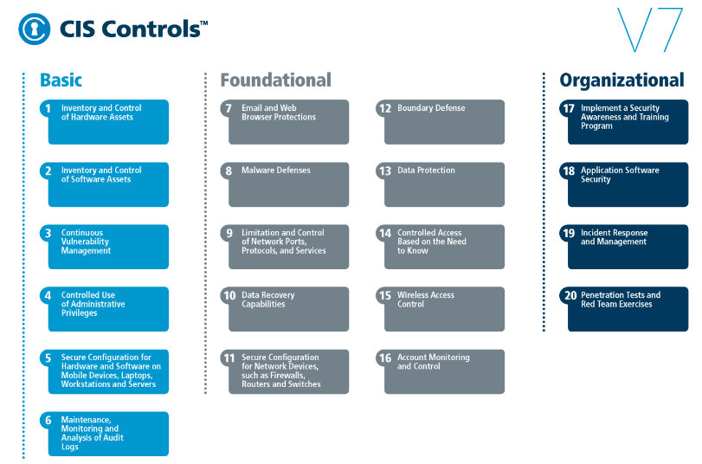
CIS CONTROL 20: PEN TESTS & RED TEAM EXERCISES-I
https://www.cisecurity.org/controls/

Slide 3
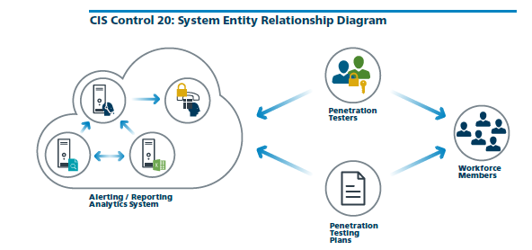
CIS CONTROL 20: PEN TESTS & RED TEAM EXERCISES-I
https://www.cisecurity.org/controls/

Slide 4
CIS CONTROL 20: PEN TESTS & RED TEAM EXERCISES-I
20.1: Establish a Penetration Testing Program
Establish a program for penetration tests that includes a full scope of blended attacks, such as wireless, client-based, and web application attacks.

Slide 5
CIS CONTROL 20: PEN TESTS & RED TEAM EXERCISES-I
20.2: Conduct Regular External and Internal Penetration Tests
Conduct regular external and internal penetration tests to identify vulnerabilities and attack vectors that can be used to exploit enterprise systems successfully.

Slide 6
CIS CONTROL 20: PEN TESTS & RED TEAM EXERCISES-I
20.3: Perform Periodic Red Team Exercises
Perform periodic Red Team exercises to test organizational readiness to identify and stop attacks or to respond quickly and effectively.

Slide 7
CIS CONTROL 20: PEN TESTS & RED TEAM EXERCISES-I
20.4: Include Tests for Presence of Unprotected System Information and Artifacts
Include tests for the presence of unprotected system information and artifacts that would be useful to attackers, including network diagrams, …

Slide 8
CIS CONTROL 20: PEN TESTS & RED TEAM EXERCISES-I
20.4: Include Tests for Presence of Unprotected System Information and Artifacts
…configuration files, older penetration test reports, e-mails or documents containing passwords or other information critical to system operation.

